Slide 1
Solving Problems using Pythagoras’ Theorem

Slide 2
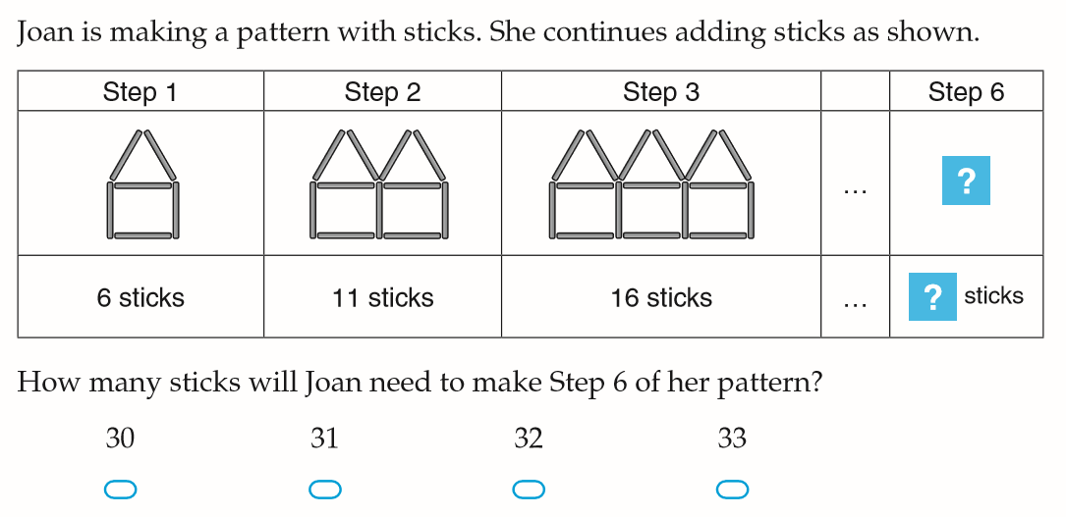
Warm Up (LHS)
Write your summary from the last lesson.
A right triangle has a hypotenuse of 10cm and one side of 6cm. How long is the other short side?
What is Pythagoras Theorem?

Slide 3
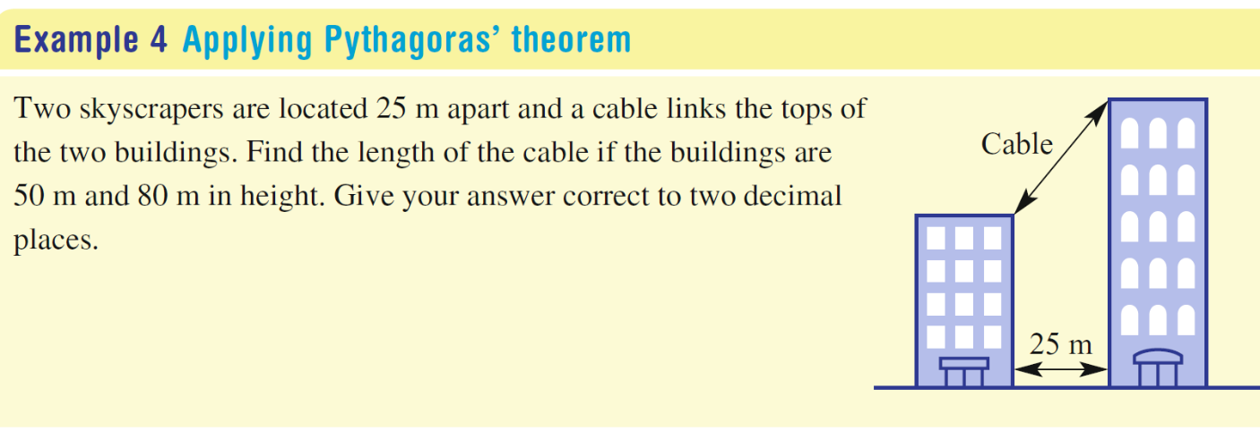
24
7
30
Topic: Right-Angled Triangles
Date
EQ – How can we solve problems involving right-angled triangles?
What are the steps?
Draw a diagram to help identify the right-angled triangles that may help solve the problem.
Label the sides with their lengths. Use a pronumeral if the length is not unknown.
Use Pythagoras’ Theorem to work out the unknown.
Solve the problem by making any further calculations and answering in words.

Slide 4
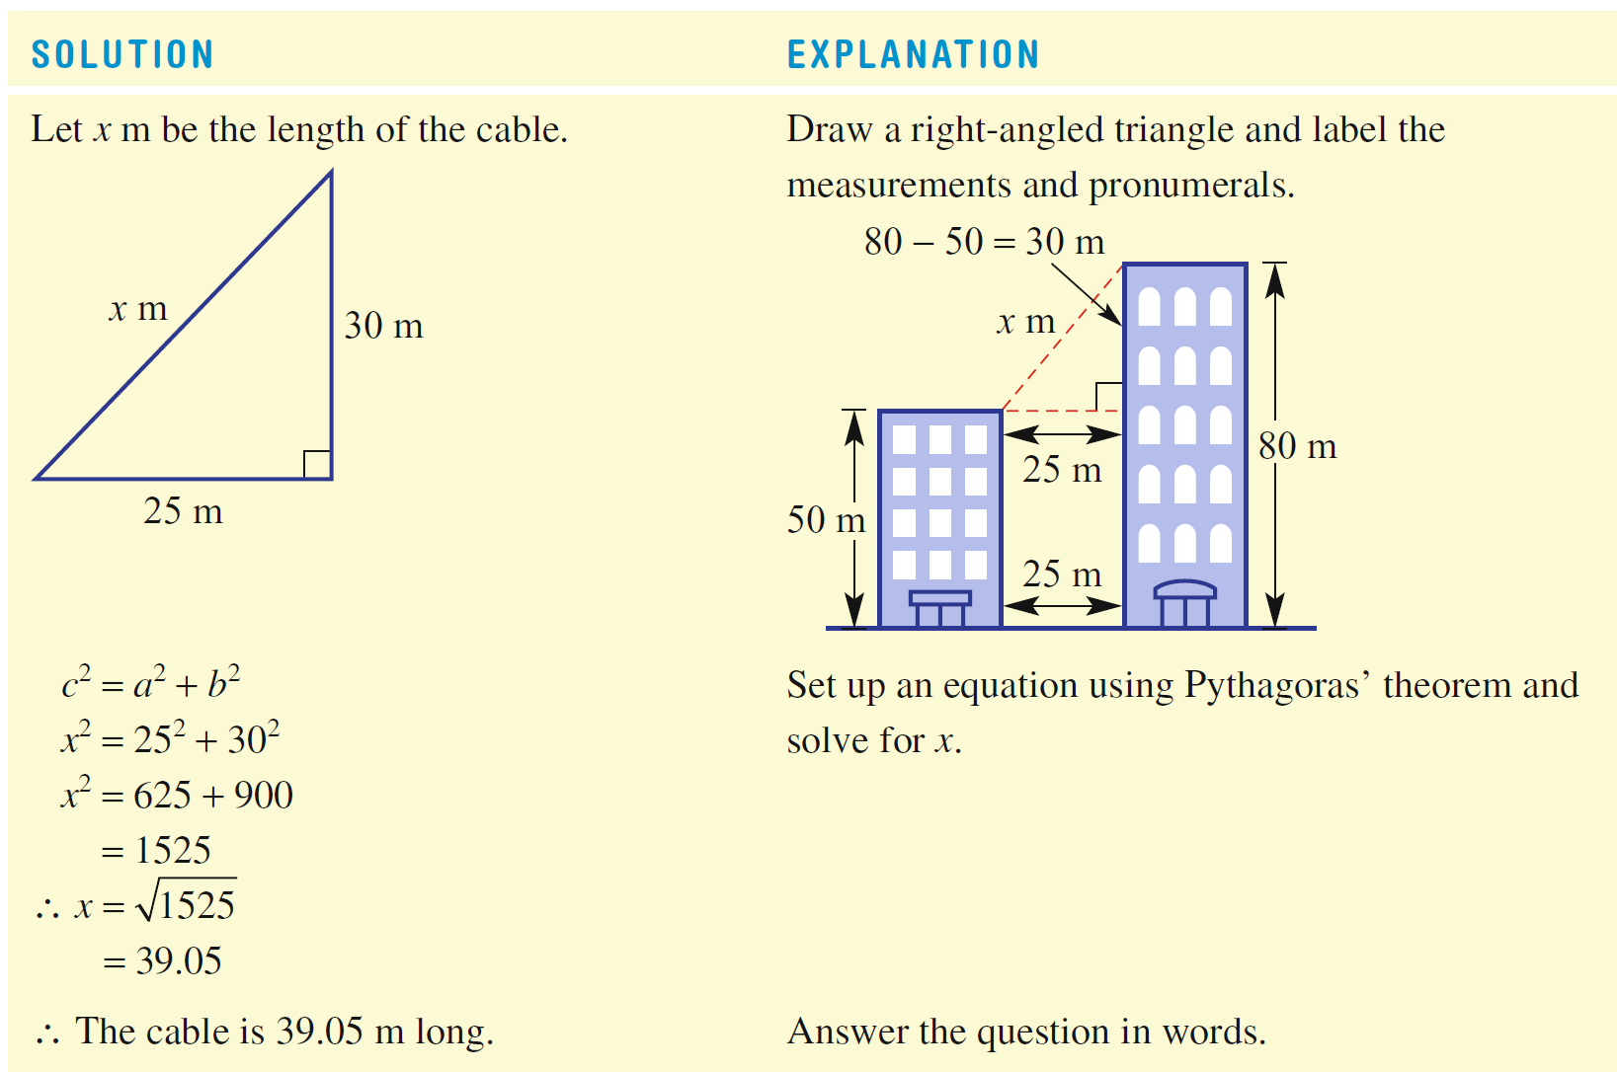

Slide 5
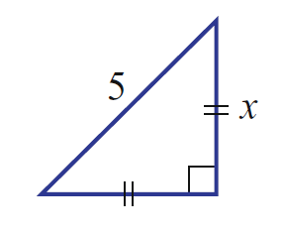
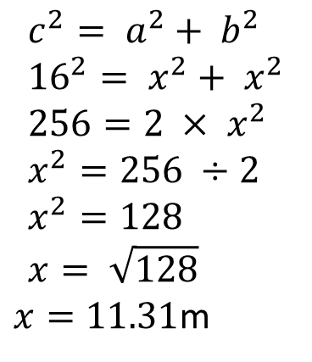
24
7
30
Topic: Right-Angled Triangles
Date
EQ – How can we solve problems involving right-angled triangles?
What if we get a right-angled isosceles triangle?
Same steps as problem solving but we have two sides of the same unknown length.
For example:
16m
$$c^{2}= a^{2}+ b^{2} \\ {16}^{2}= x^{2}+ x^{2} \\ 256=2 × x^{2} \\ x^{2}=256 ÷2 \\ x^{2}=128 \\ x= \sqrt{128}$$ $x=11.31$m

Slide 6


Slide 7
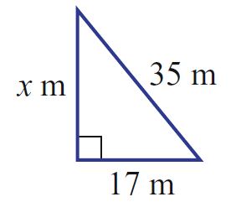
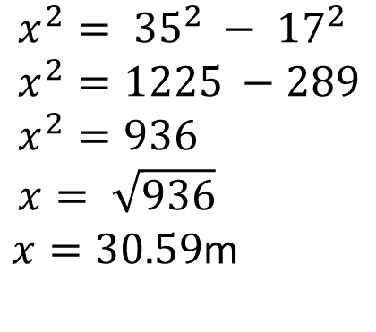
We Do
A kite is flying on a string that is 35m long. Its horizontal distance from its anchor point is 17m.
How high is the kite flying?
$$x^{2}= {35}^{2} − {17}^{2} \\ x^{2}=1225 −289 \\ x^{2}=936 \\ x= \sqrt{936}$$ $x=30.59$m

Slide 8
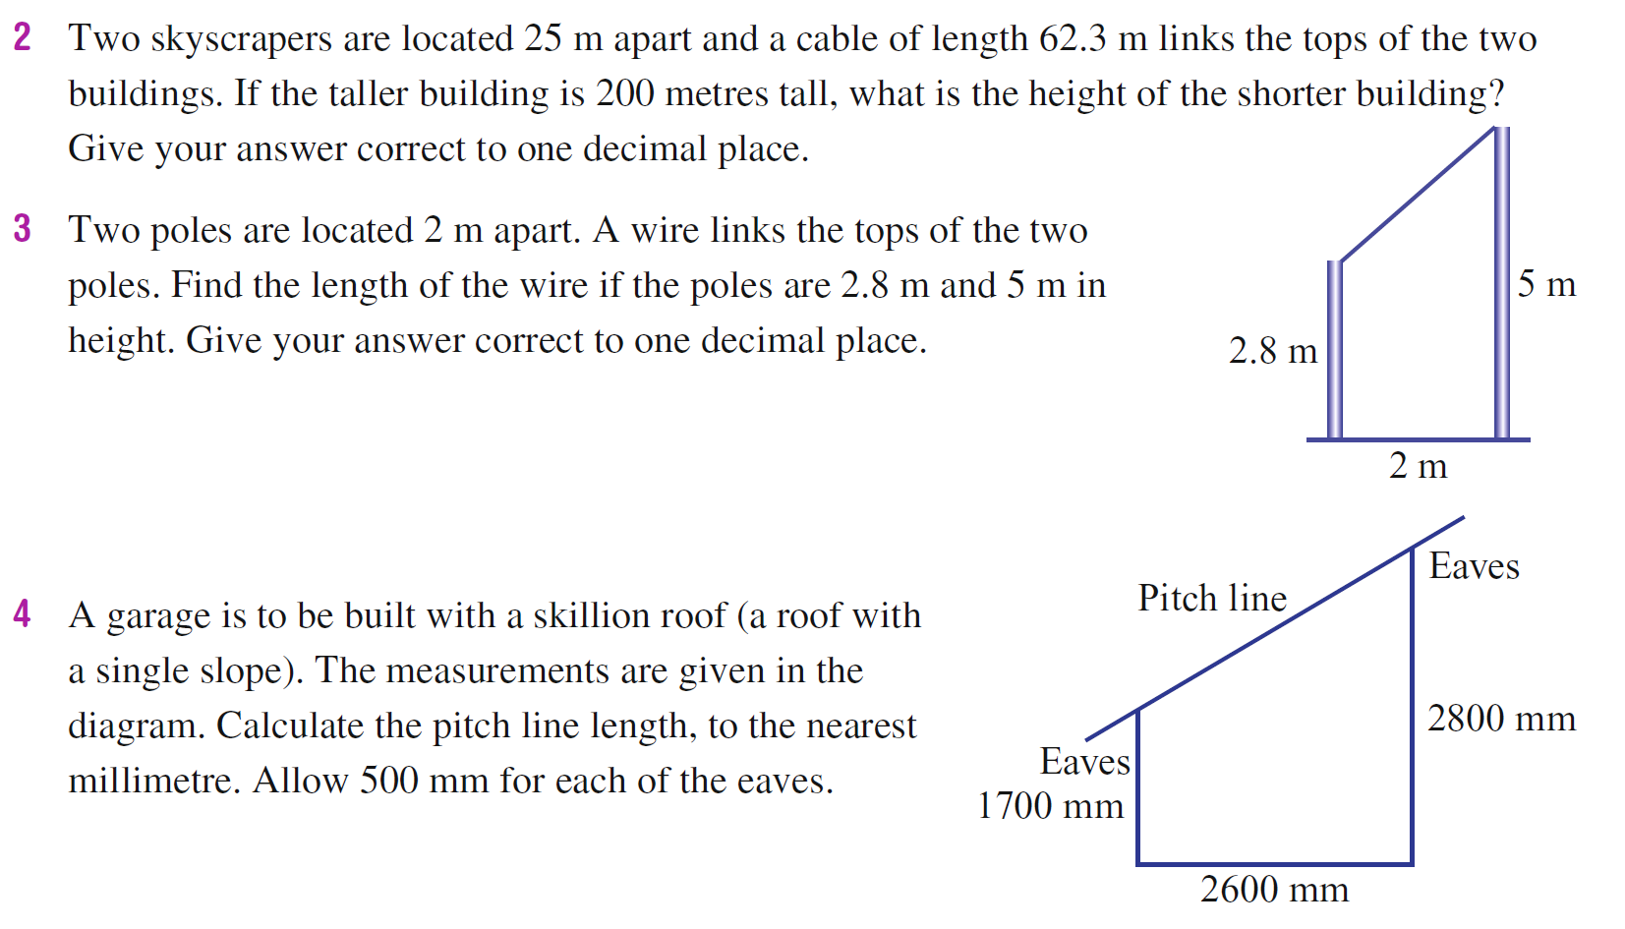
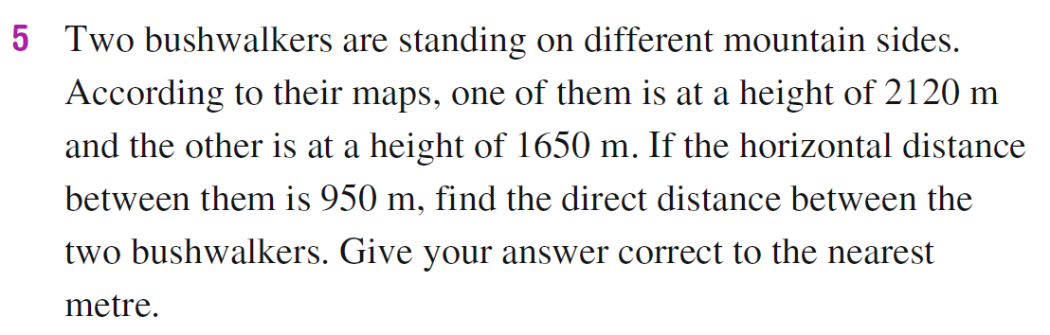
You Do

Slide 9
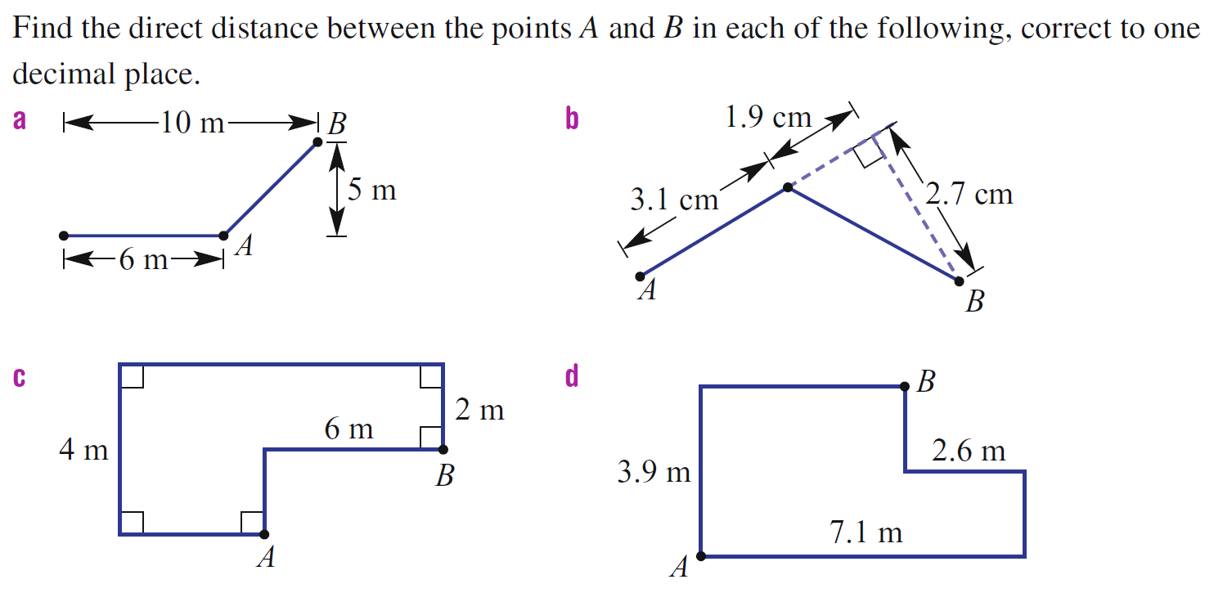
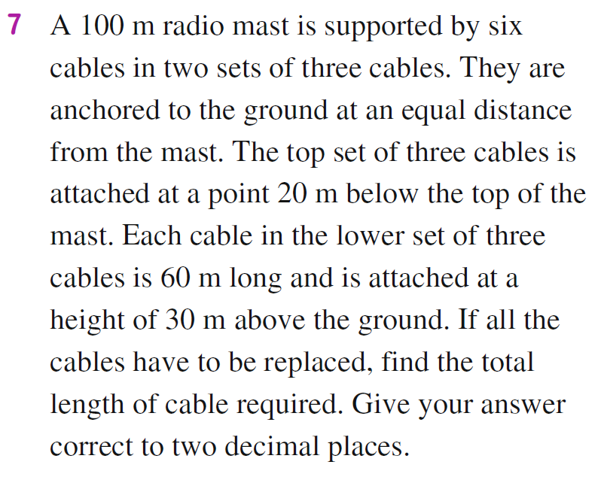
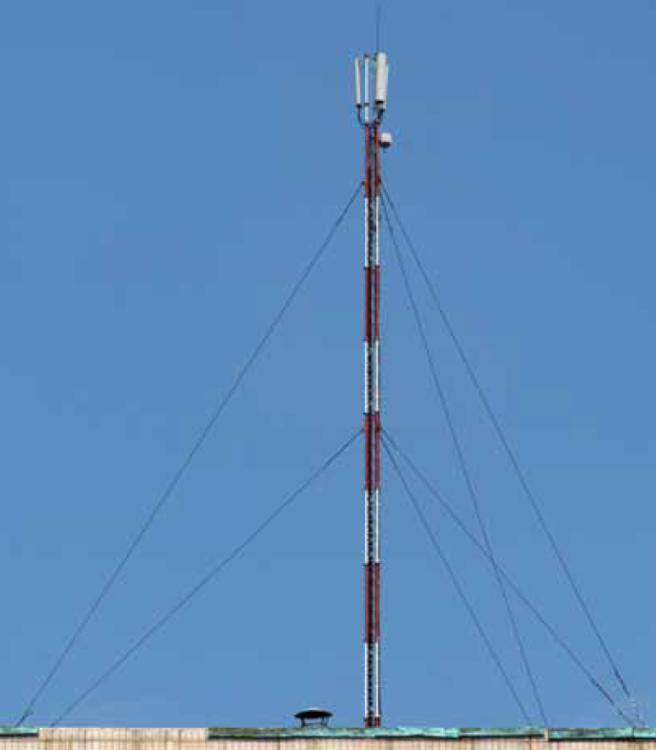
Extension

Slide 10
Exit Pass
Calculate the shorter sides of this isosceles triangle to 2 decimal places.

Slide 11
24
7
30
Topic: Right-Angled Triangles
Date
EQ – How can we work out the sides of right-angled triangles?
Summary

